Slide 1
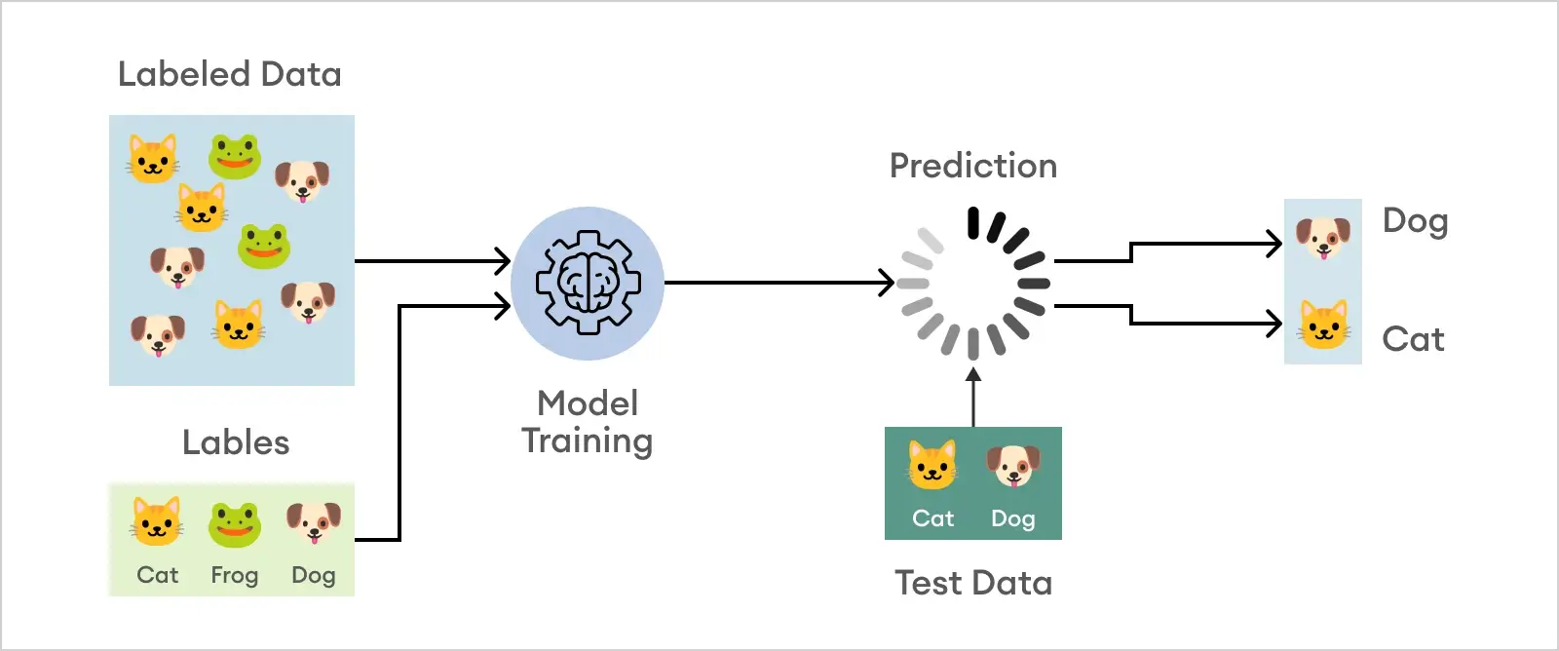
Image Classification by Deep Learning
Submitted by
Intern Roll No: MST03-0024
Name: Vijaiey Anand S
Guide: Ms. Urooj Khan

Slide 2
Objective
Developing an image classification model using deep learning.
Classify images into 'City' and 'Nature' categories.
Achieve high accuracy in image classification.

Slide 3
Dataset
The dataset contains nature and city images with 150*150 pixels.
For training 1520 images for each.
For testing 300 images for each.
The input size of the image is changed to 224*224 since using VGG16 and batch size taken as 32.

Slide 4
Tech Stack
TensorFlow
Keras
Python
Matplotlib

Slide 5
TensorFlow: Deep learning framework for building and training neural networks.
Keras: High-level neural networks API, simplifying the process of building and training models. TensorFlow 2.0 was released in 2019, with integration of Keras.
Python: Programming language used for scripting and implementing the model.
Matplotlib: Visualization library for generating plots and graphs to analyse model performance.

Slide 6
Model
The model used was Convolutional Neural Network by deep learning.
Key Components:
Convolutional Layers: Apply convolutional operations to the input, extracting features and patterns.
Pooling Layers: Downsample the spatial dimensions of the input, reducing computational complexity and controlling overfitting.
Fully Connected Layers: Basic neural network layers that learn the relevant patterns in the extracted features.

Slide 7
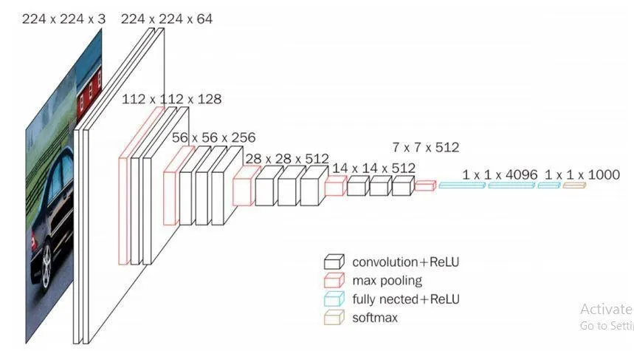
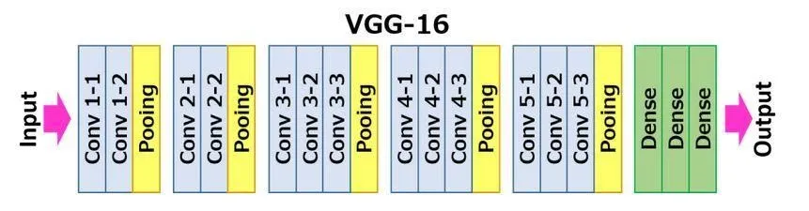
VGG16 Architecture

Slide 8
Work flow
Data(Image) Generation
Data augmentation
Model Development
Classification model using the VGG16 architecture
Model Training and Evaluation
Adam optimizer, Binary Cross Entropy Loss, Accuracy
Prediction
Use trained model predict class for new image

Slide 9
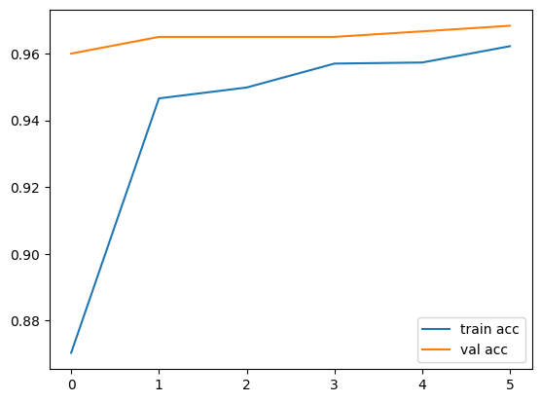
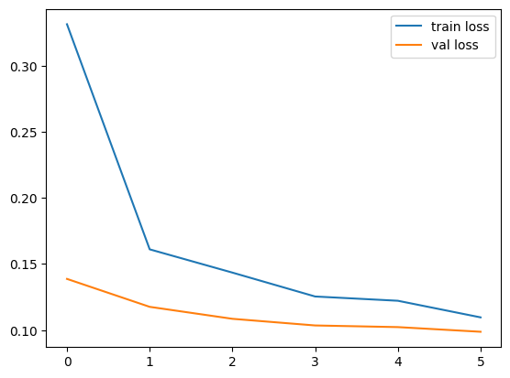
Accuracy and Loss Graph

Slide 10
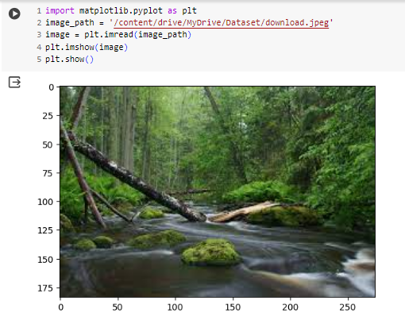
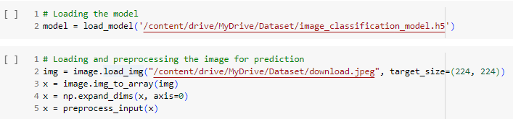
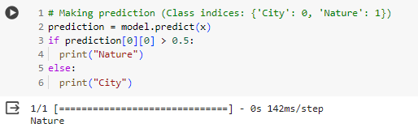
Prediction

Slide 11
Conclusion
The Image classification model presented demonstrates accuracy of 96.83 for testing set.

Slide 12
Thank you!

